Slide 1
Quantization Noise in Advanced LIGO Digital Control Systems
Ayush Pandey
Mentors: Christopher Wipf, Jameson Graef Rollins, Rana Adhikari

Slide 2
Project Introduction
Mixed Signal Systems
Digital Control vs Analog Control
Quantization Noise: One of the major demerits of Digital Control Systems
Causes of Quantization Noise
Notes:
analog + digital
better noise performance
better sensitvity
flexible programming
complex filter implementations
disad: quantization

Slide 3
Quantization Noise
In Analog: 1.25 + 2.34500000199999 = 3.59500000199999
In double precision computer,
(1.25) + (2.34500000199999) = 3.5950000012
Quantization Noise = (approximately) 10⁻¹²
Similarly, two (B+1) bit numbers, on multiplication give a (2B+1) number which then needs to be truncated for a B+1 precision computer

Slide 4
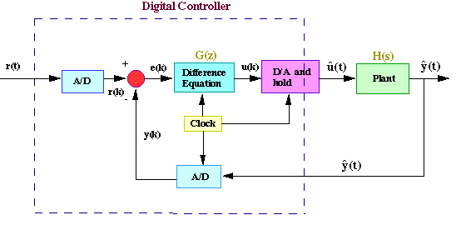
Digital Control System : I
Reference: National Instruments

Slide 5
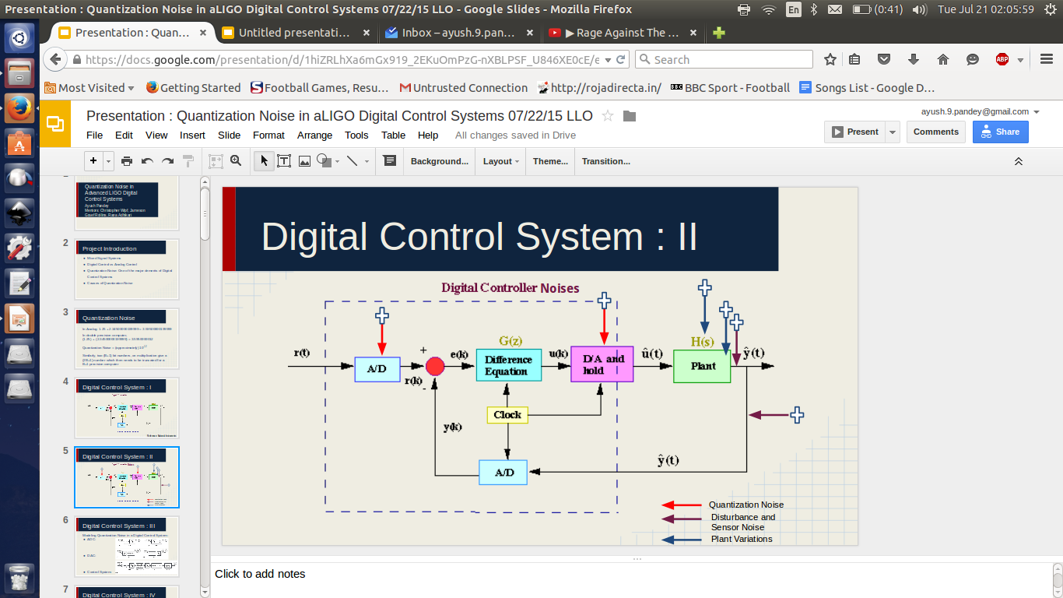
Digital Control System : II

Slide 6
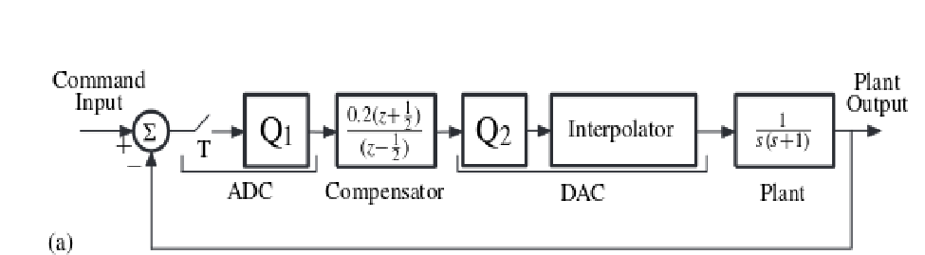
Digital Control System : III
Modeling Quantization Noise in a Digital Control System:

Slide 7
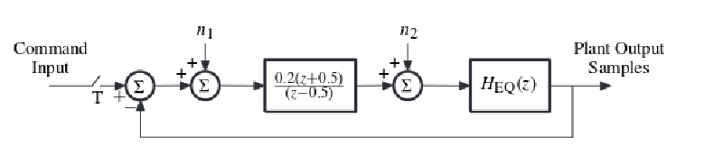
Digital Control System : IV
With Approximate Additive Quantizer Model:
Reference: Widrow and Kollar
Book on Quantization

Slide 8
Sources and Measurement
Three primary sources:
Finite Precision of Digital Computers (ADC Quantization Noise)
Mathematical Calculations (Digital Filter Quantization Noise)
Truncation of Numbers to drive finitely precise DAC (DAC Quantization Noise)
Notes:
also speak about measurement of noise in each part, theory.

Slide 9
Improvements Possible
To improve digital filter performance:
Change filter structure
Better the precision
Error Feedback
To improve DAC performance:
Use higher precision DAC
Noise Shaping
For ADCs:
Change Hardware Implementation and Design (Algorithm)

Slide 10
Quantization Noise Analysis of the Digital Controller

Slide 11
Background
Filter Structure (Mathematical Operations, Order)
State Space Representation of Digital Filters
Low Noise Form (Matts Evans)
Time Complexity and Performance
For double precision implementation: (ref. Denis Martynov)
Output(double)-Output(single) = Noise(single)
Noise(double) = Extrapolation factor * Noise(single)

Slide 12
Improvements in Noise Estimation
Precise Noise Estimation
SNR Distribution and Warning System
Code running time
SNR Plot

Slide 13
Automatic Digital Controller Checker Tool
A software tool based on MATLAB which performs the following:
Searches for valid channel names (For sites, only recorded channels)
Construct channel names from filter modules in Foton file archive (for all files)
Download Data -> Perform Noise Estimation -> Plot
Save the Data for future analysis...and repeat.

Slide 14
Testing on 40m Controller
Caltech’s 40m prototype Interferometer Digital filters were Analyzed

Slide 15
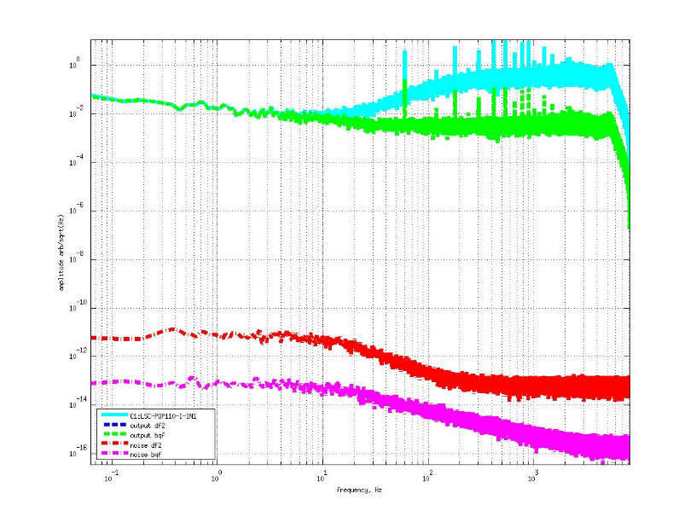
LSC-POP110_I filter

Slide 16
For aLIGO sites
Remote Access to input/output data for digital filters
Only channels that are recorded
Some output channel (only) recorded filters have been checked by inverting the filter
Foton file archive checked out of SVN at
Hanford: GPS Time: 1117896120 : Jun 9 14:41 UTC
Livingston: GPS Time: 1117562416: Jun 5 18:00 UTC
The complete set of resultant plots is available at :
https://drive.google.com/folderview?id=0BzjRW8WwGjzJfkE3cVFzczJVU0JpSkZUTm1DR0dpWF9BWFlNVTh3VGg3UG93dHRLTURPZWs&usp=sharing

Slide 17
Observations and Inferences
General Behaviour
--Digital Filter Noise is way below Output spectrum level.
Notes:
1. The filters giving output having a high phase lag (the output magnitude decreases steeply with frequency):
--The quantization noise level remains the same (showing white noise characteristics, to an approximation) and hence the SNR falls down as the output falls down. This is a very common observation and has been observed for hundreds of filters. This suggests that if the output falls too steeply (having a very high slope), then it will catch the noise. This could happen for the range of frequencies which concern us. Hence, the filter design shouldn't have many poles together at DC, as having many poles at DC causes the filter to behave in the way described above. Also, other than this the filter design process should take in consideration the quantization noise level (which is in the range of 10^(-8) to 10^(-15)) while designing filters for which output falls continuously so that it doesn't get near to the quantization noise level.
2. When the Low Noise form performs the same as the Direct Form II
3. When the Low Noise form performs worse than Direct Form II
4. When SNR is not "as" high as for "most" of the filters for the Low Noise Form
5. Filters for which the Direct Form II quantization noise power spectrum density is above the output for a range of frequencies
6. For some filters, the high frequency roll-off is sudden and steep. This causes it to catch the noise level, especially for the DF2 case. But this occurs at nyquist frequency and hence is not as alarming.
7. The order by which the LNF performs better than DF2 is in the range of 10^-2 to 10^-4 for more than 80% of the filters.
8. Some filters have a high Q notch at some frequencies. But, this hardly had any effect on the quantization noise level as it maintained it's constant (approximately constant) nature. Maybe this fact along with others show that the quantization noise is independent of the input signal. The independence is further strengthened by the fact that even for changes in input of the order of 10^10 the noise maintained it's level.
9. The above fact can be easily contradicted by citing examples of many filters which show variations in the noise level with variation in input. Hence, the only conclusion is that the quantization noise level is independent of the input signal to a certain extent and to a certain approximation. There is a slight nature of dependence present as well.
10. For some filters, the DF2 noise was 10^7 times above the LNF noise, which is not a common case. One such filter design is: ISI_GND_BRS_ETMX_RY.
11. When input signal is a very low order signal (around 10^-7 or more), the SNR is worse than for most of the filters. A combined effect is shown by the filters which behave as described in (1) and which have low input values. These filters have considerably lower SNR than others.

Slide 18
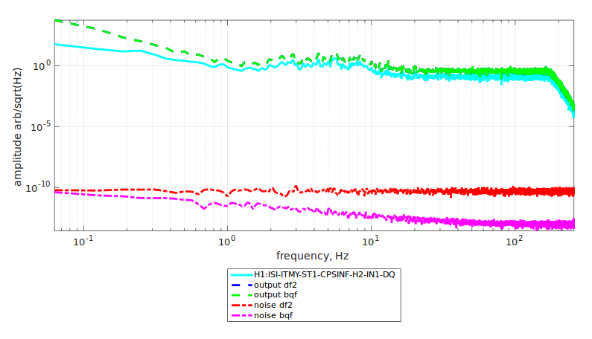

Slide 19
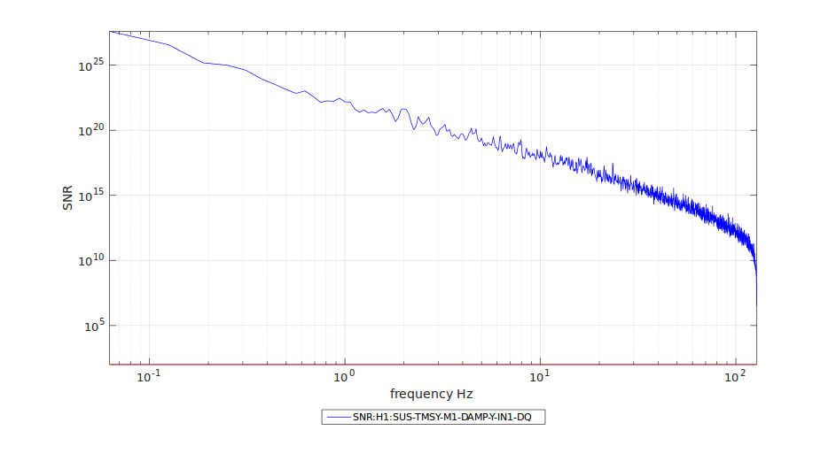

Slide 20
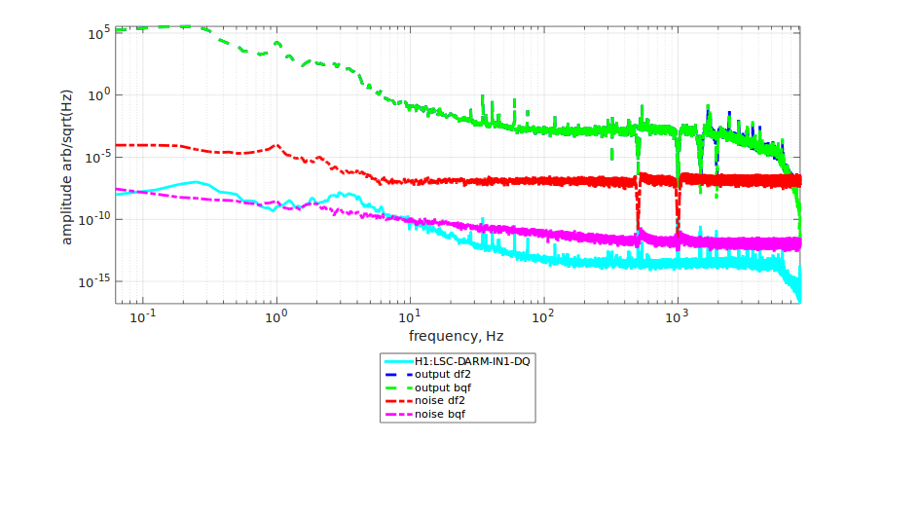
Filters with High Phase Lag (Higher Order filters)
--SNR level lower

Slide 21
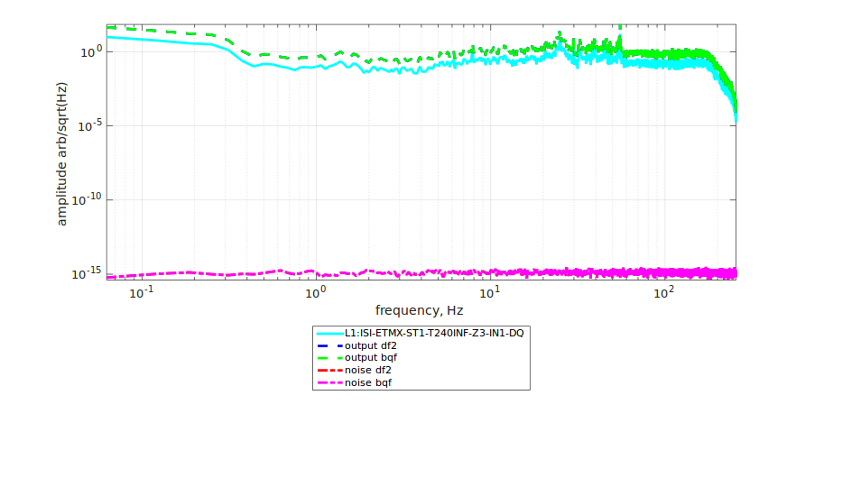
DF2 performs equally well as LNF
--Gain like filters/filters not performing many calculations

Slide 22
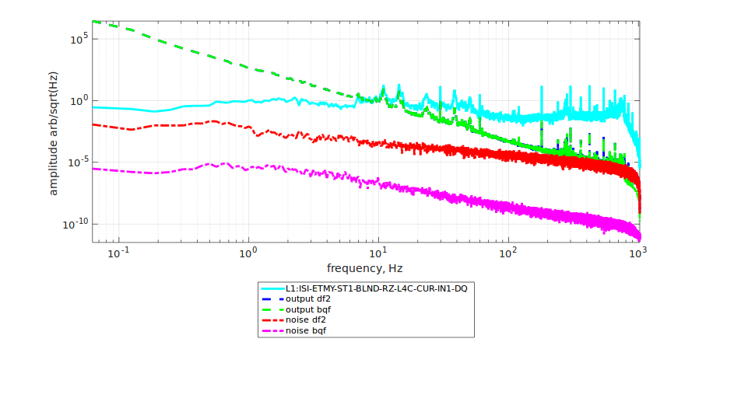
DF2 above output spectrum
--When Input signal is of very low order + High Phase Lag filter (Combined Effect)

Slide 23
Other Observations and Inferences
Dependence and Independence on Input
--Inference: More on the independent side. To an approximation.
Generally, LNF is better than DF2 by an order of 100 -10,000 SNR

Slide 24
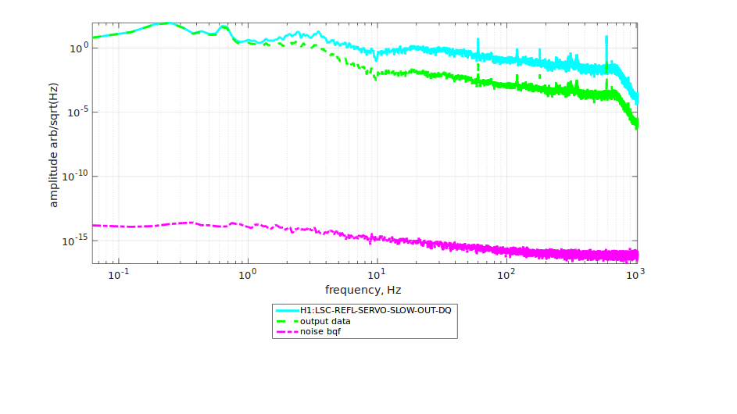
Filter Inversion

Slide 25
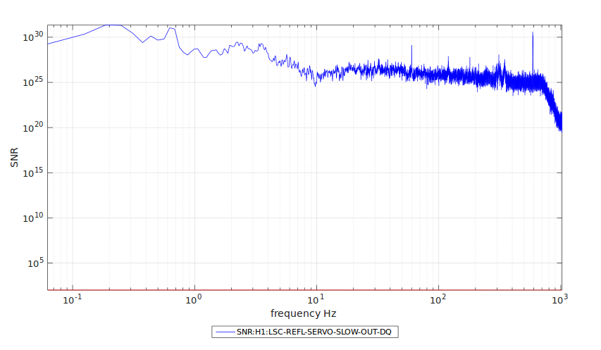

Slide 26
Limitations and Conclusions
A major limitation :
History of filters: The case when a filter is an integral type or higher order integrals
Remedy: Proper Sample time for the filter
Only recorded channels tested, but there could be problems within the controller
Major conclusion: LNF filter performs great for most filters (>90%). Even for the other 10%, SNR > 10² -10³
Not all filters can be inverted (from Output to Input) for analysis

Slide 27
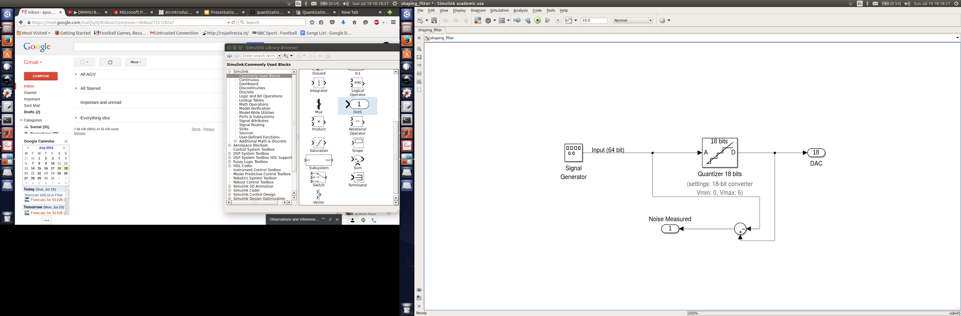
DAC Quantization Noise

Slide 28
Ways to mitigate DAC Noise
Using higher precision DACs
But, there are hardware limitations
Also, processing speed
DAC architecture improvements
DAC Noise Shaping
Low noise in a particular band of frequencies at the cost of higher overall noise level.

Slide 29
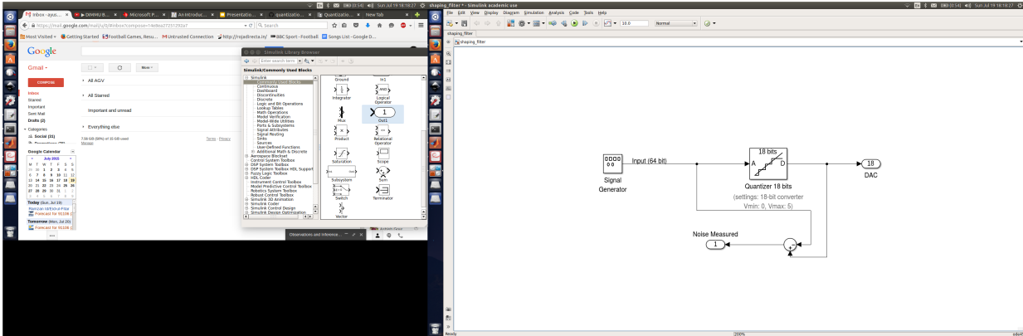
DAC Noise Measurement

Slide 30
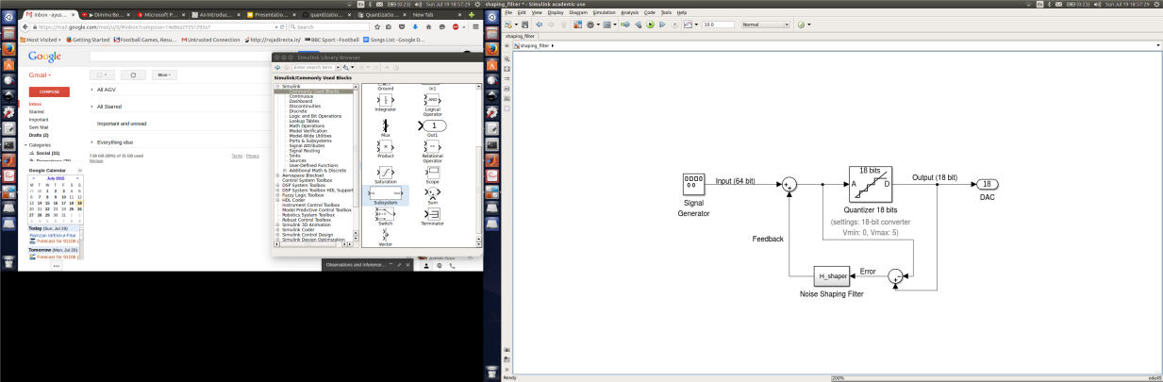
DAC Noise Shaping

Slide 31
Background : Noise Shaping
On simple block diagram analysis,
X’(z) = X(z) + E(z) (-1 + H_shaper(z))
where, X’(z) is output transfer function in z-domain
and similarly, X(z) is input, E(z) is quantization error
and H_shaper(z) is feedback transfer function
Since, the noise needs to be fed back after a delay, the above equation is modified to be like:
X’(z) = X(z) + E(z) (-1 + z⁻¹H_target(z))
where the delay is accounted for in the code.
Essentially, noise is now “shaped” or modified according to our own choice.

Slide 32
Customized Noise Shaping for aLIGO DAC
The robustness of the noise shaping algorithm.
Suppress any peak (notch) in Quantization noise
Or, suppress a particular band of frequencies all together. With a compensation elsewhere.

Slide 33
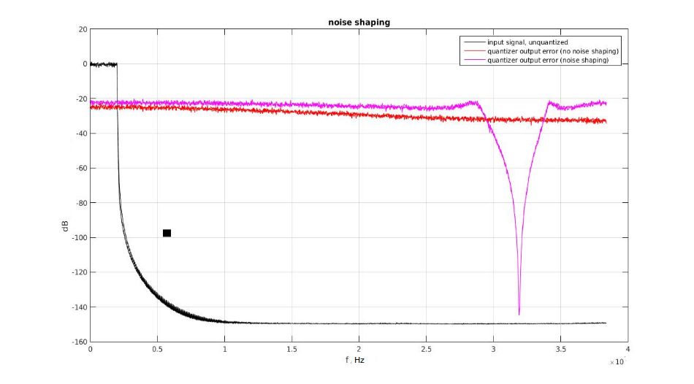

Slide 34
Simulations in MATLAB
Algorithm implemented in MATLAB gave successful results for any arbitrary noise shape.
For a high pass shaped noise (which is desirable for GW detection):
Plot : Next Slide

Slide 35
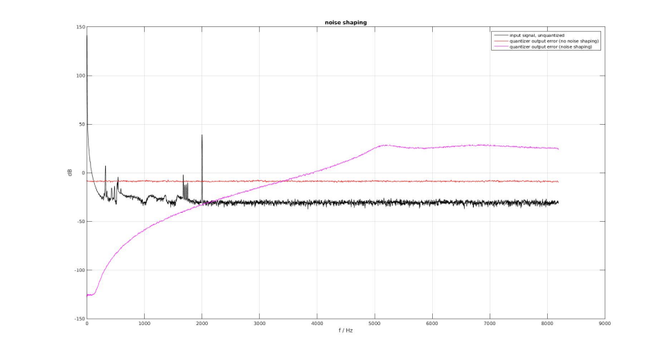

Slide 36
Implementation in C
To enable the frontend code to take advantage of the noise shaping algorithm developed.
Filtering done using SOS coefficients
No plotting in this case, hence error debugging with respect to MATLAB simulation results
Noise shaped data given to the DAC

Slide 37
Project Conclusions and Scope
There are two major conclusions of the project work and the research done in this project:
For most of the filters analyzed, the low noise form performed better than DF2 and also SNR for most of them was acceptable.
That being said, an exclusive testing of the controller still remains to be done as signals inside the controller were not tested.

Slide 38
Project Conclusions and Scope
DAC Quantization Noise
A primary concern due to its higher level has been mitigated
to a great extent, according to the noise
shaping algorithm proposed.
The future scope would be to completely implement it
in the system and take advantage of it.

Slide 39
Q & A
Thank You!

Slide 40
ADC Quantization Noise
Hardware Limitation of any digital signal processor chip (computers)
ADC Design : Effect on Noise
SAR (Successful Approximation Register) ADC
Low Power Consumption
Limited sample rate
Flash ADC
Fast and Simple (Direct)
Cost and Power Consumption High
Sigma Delta ADC
Low Quantization Noise
Simple Design
Latency and Low Speed
Notes:
A successive approximation ADC is a type of analog-to-digital converter that converts a continuous analog waveform into a discrete digital representation via a binary search through all possible quantization levels before finally converging upon a digital output for each conversion.

Slide 41
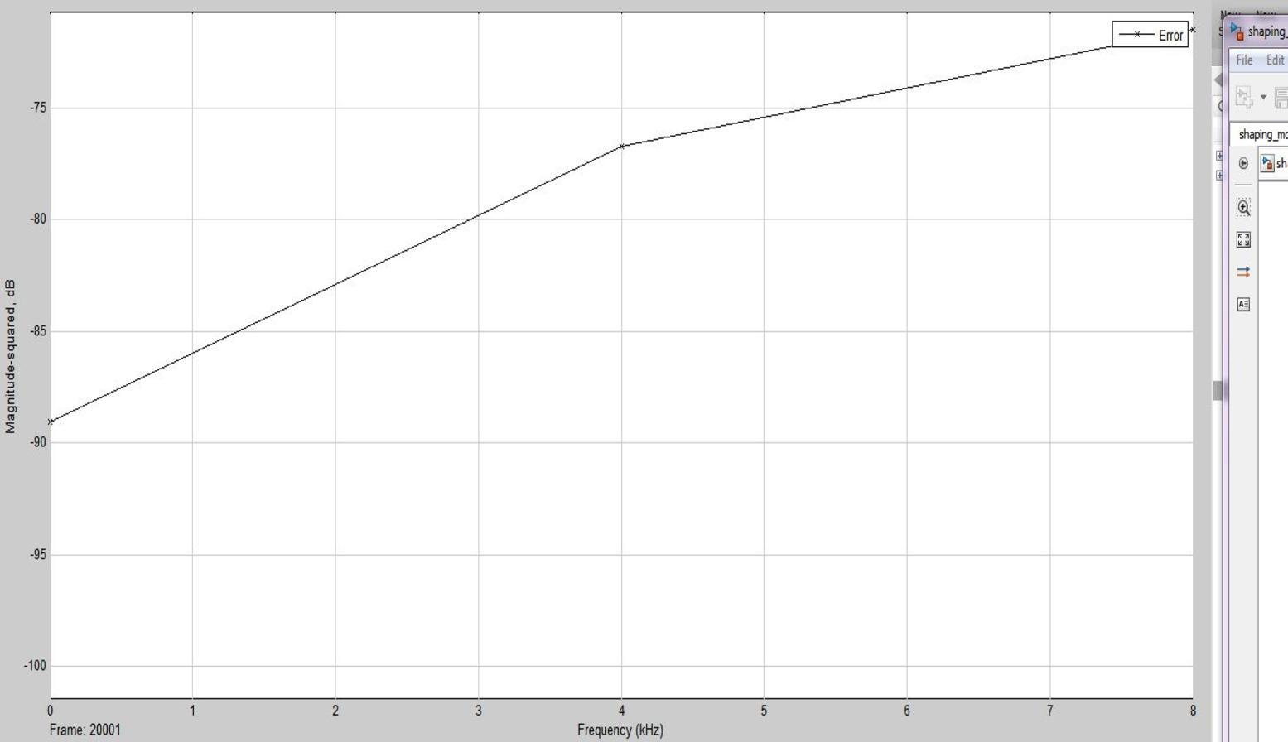
Project Part I: ADC Quantization Noise
Simulation of PSD with Delta-Sigma ADC
Oversampling
Noise Shaping by using feedback
Decimation

Slide 42
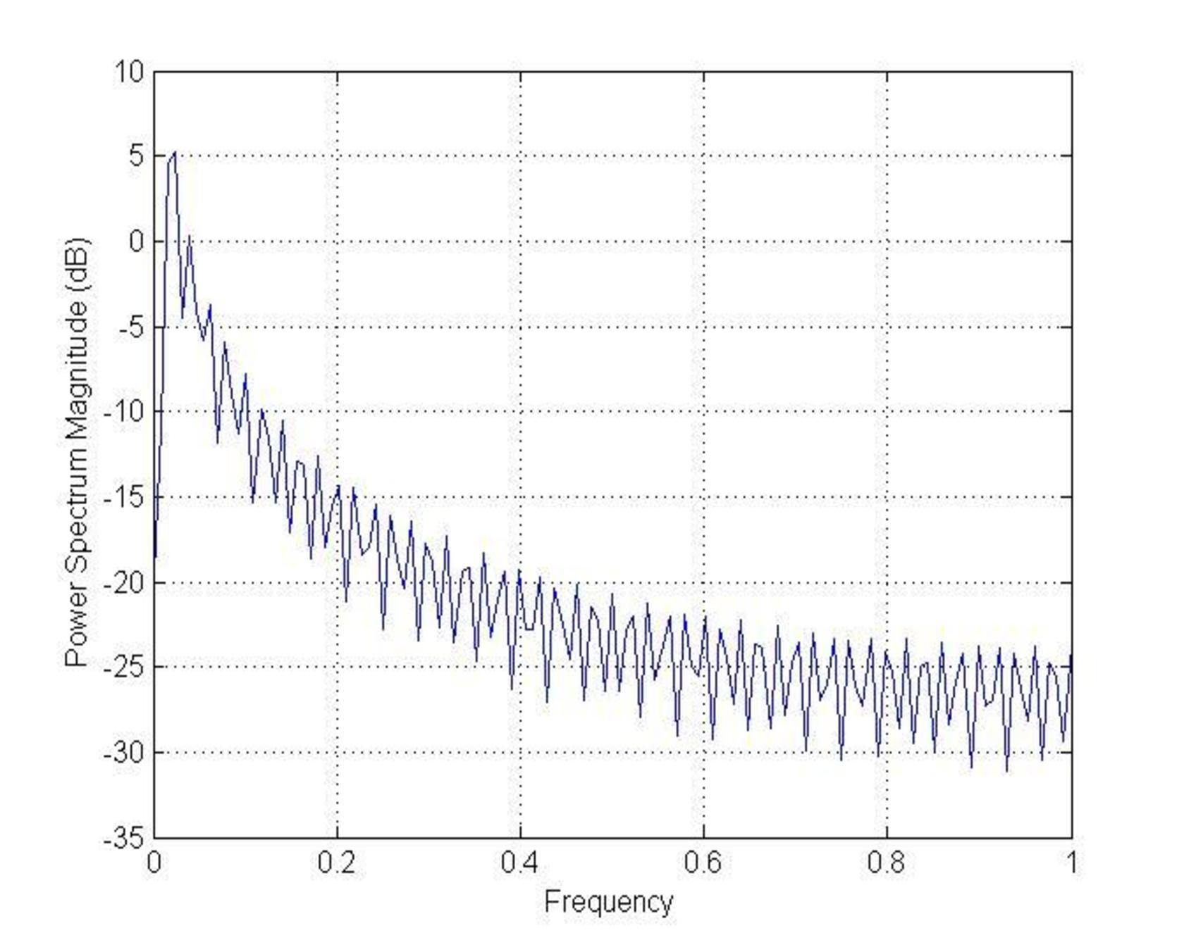
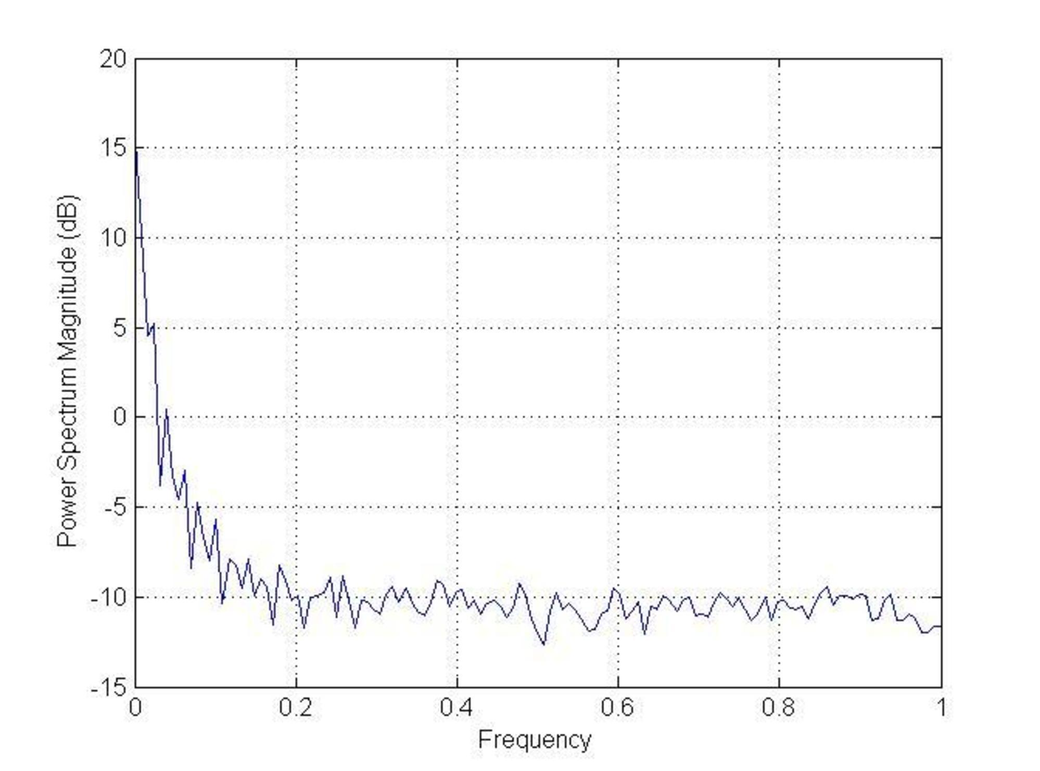
Dithering
Effect of Dithering the Input, Simulation Results
Without Dither
With Dither

Slide 43
Future Scope and Conclusions:
A novel ADC architecture design to reduce quantization noise
Simulations for well-known theoretical facts such as:
Dithering helps in making noise white
Sigma-Delta ADC quantization noise shaping
Since, DAC and digital filter noise levels are above ADC noise, in-depth analysis was skipped.
Work on ADC hardware to implement noise shaping could be done later

Slide 44
DAC Quantization Noise
Precision (DAC) < Precision(Filter)
Hence, truncation of bits!
Moreover, data type conversion introduces quantization. For eg: Floating Point (double) to integer

Slide 45
Digital Filter Quantization Noise
Noise during Addition
Noise on Multiplication
Order of mathematical operations, filter structures

Slide 46
Comparison
DAC Quantization Noise floor is above the Digital Filter Noise floor. Hence, is of a bigger concern.
While, Digital Filter noise was close to the output at around nyquist frequency range, the DAC noise is close to the output at much lower frequencies.
Reason is clear:
Digital Filter Noise results from subtraction of a 64 bit and a 80 bit floating point numbers.
DAC noise results from subtraction of a 64 bit floating point and a 18 bit (fixed point) number.

Slide 47

Noise Shaping
The noise takes the shape according to the H_shaper filter design.
Can be effectively used to push the quantization noise out of the GW detection band.

Slide 48
Quantization Noise Magnitude and Phase Delay Response
For GW detection, the main requirements for noise is that the noise magnitude should be very low in 10-100 Hz range

Slide 49
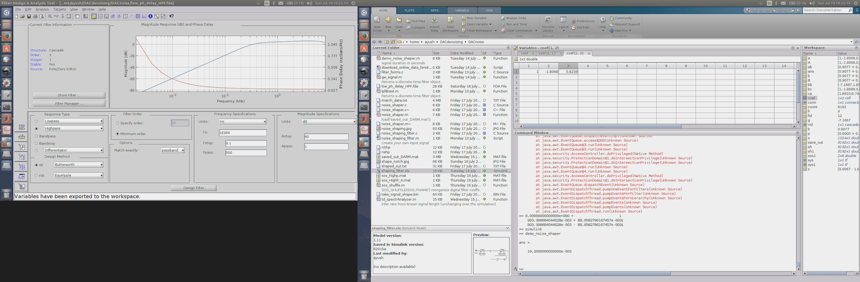
Noise Shaping Filter Design
A filter was designed in MATLAB using the fdatool by placing poles and zeros accordingly, to follow the guidelines mentioned above. Here is the response of the filter:
Red: Phase Delay
Blue: Magnitude

Slide 50
Theoretical Background
Maximum Quantization Error possible = ±0.5 LSB
Quantizing Theorems I and II (Widrow and Kollar)
Quantizers can be modeled as additive noise source, under some given conditions.
Quantization Noise on performing Mathematical operations using Fixed Point and Floating Point is different.

Slide 51
Fixed Point Quantization Noise
Free of quantization noise on addition
But, Overflow is possible
Multiplication operation leads to noise
Depends on order of calculations (i.e. poles and zeros in filters)
Cascade form of SOS sections better than parallel form (ref. )

Slide 52
Floating Point Quantization Noise
Assumptions, such as:
Noise independent of input signal
Modeling as white noise source (additive model)
...cannot be justified.
Overflow doesn’t occur, in practice.
In special cases, such as white noise input (ref.)
Quantization noise can also be assumed white
Independent of SOS ordering

